Slide 1
Graphs of the form y = x^{n}
for n ≥ 0

Slide 2
Graphs of the form y = x^{n} all go through the point (1, 1)
The even powers, y = x⁰, x², x⁴ … also go through ( – 1 , 1)
and the odd powers, y = x¹, x³, x⁵… go through ( – 1 , – 1)
So I will use – 1 ≤ x ≤ 1 as the domain for each graph

Slide 3
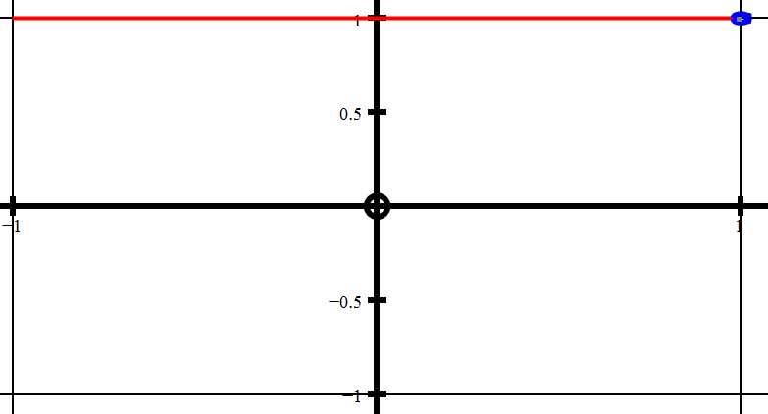
y = x⁰ = 1

Slide 4
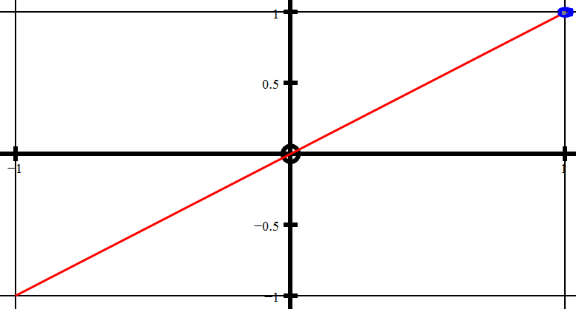
y = x¹

Slide 5
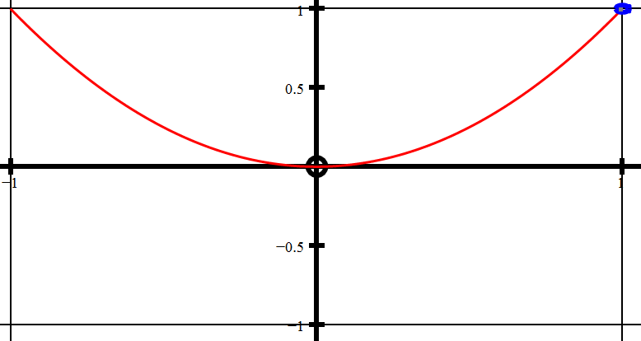
y = x²

Slide 6
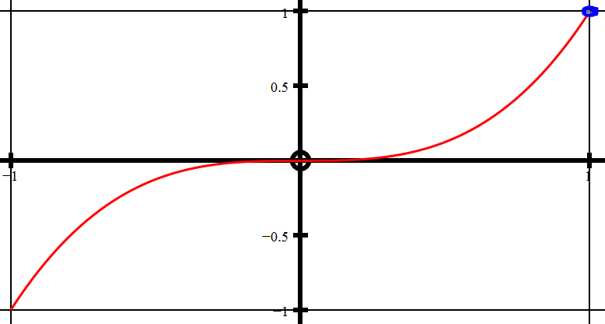
y = x³

Slide 7
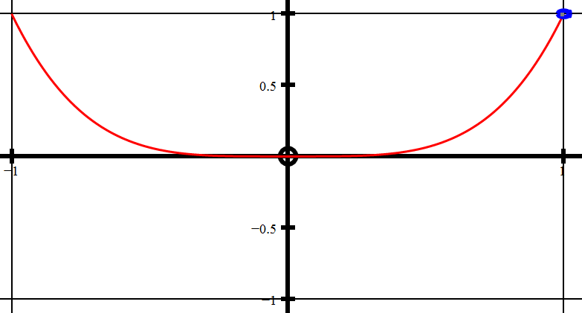
y = x⁴

Slide 8
y = x⁵

Slide 9
However, if we increase the power n in steps of 0.1 a strange thing happens.
When n = 0, 1, 2, 3, 4, 5… we get the familiar curves as we just saw but when n takes the values 0.1, 0.2, 0.3, …..up to 0.9 the left hand side of the curve vanishes!
The same thing happens for n = 1.1 to 1.9 and again for
n = 2.1 to 2.9 etc
The left hand side of the curve appears to vanish for non whole number values of n because it does not exist in 2 dimensional space!

Slide 10
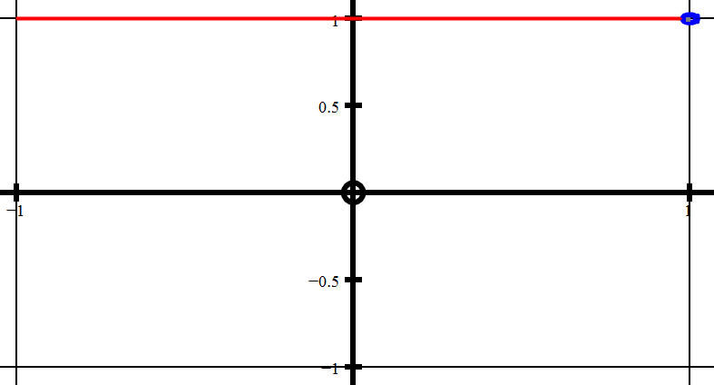
y = x⁰

Slide 11
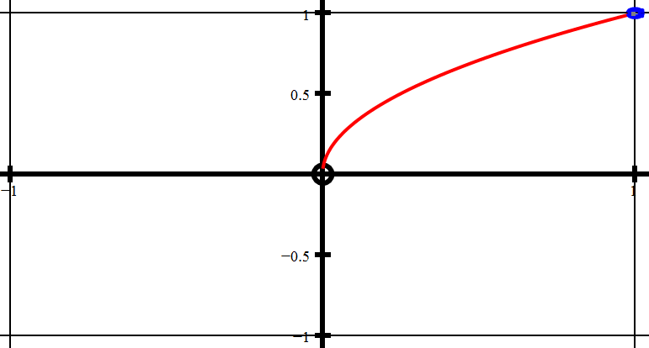
?
y = x^{1/2}

Slide 12
y = x¹

Slide 13
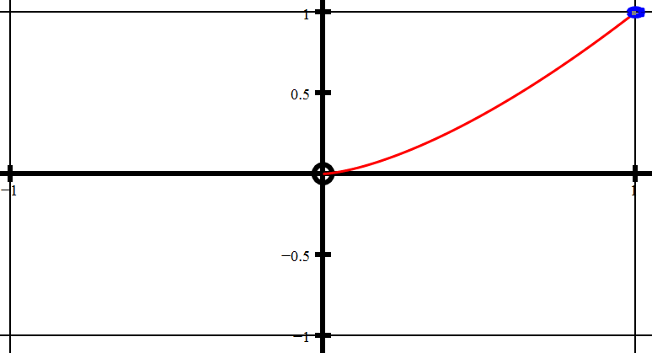
?
y = x^{1.5}

Slide 14
y = x²

Slide 15
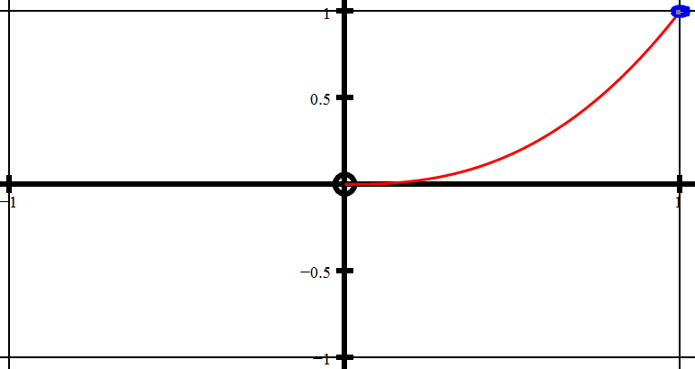
?
y = x^{2.5}

Slide 16
y = x³

Slide 17
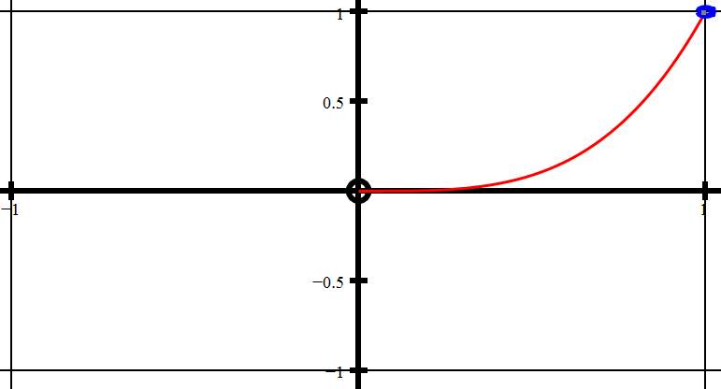
?
y = x^{3.5}

Slide 18
y = x⁴

Slide 19
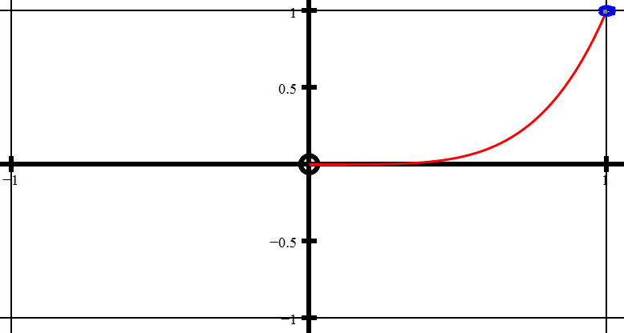
?
y = x^{4.5}

Slide 20
y = x⁵

Slide 21
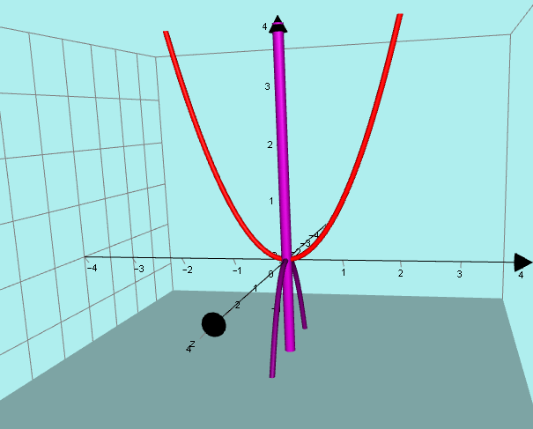
This is different from the normal “phantom graph” theory where we have REAL y values and a COMPLEX x plane

Slide 22
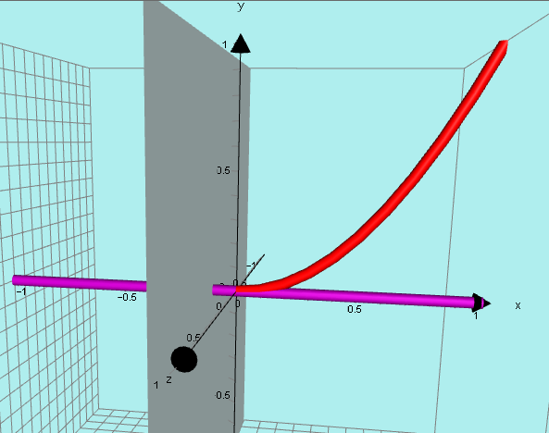
In this situation we have REAL x values and a COMPLEX y plane.

Slide 23
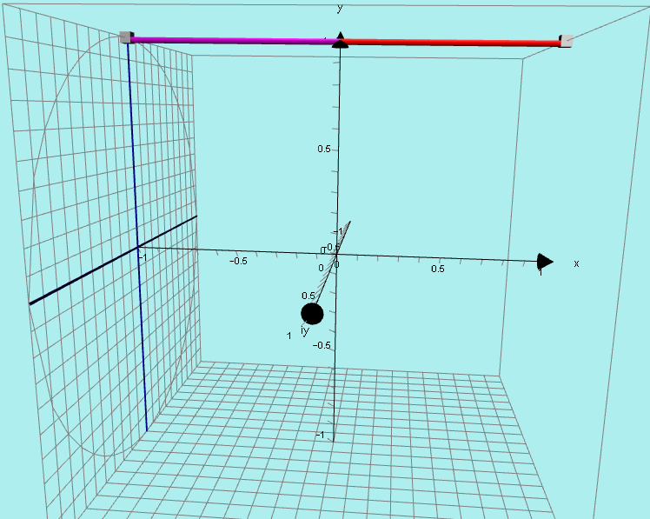
y = x⁰

Slide 24
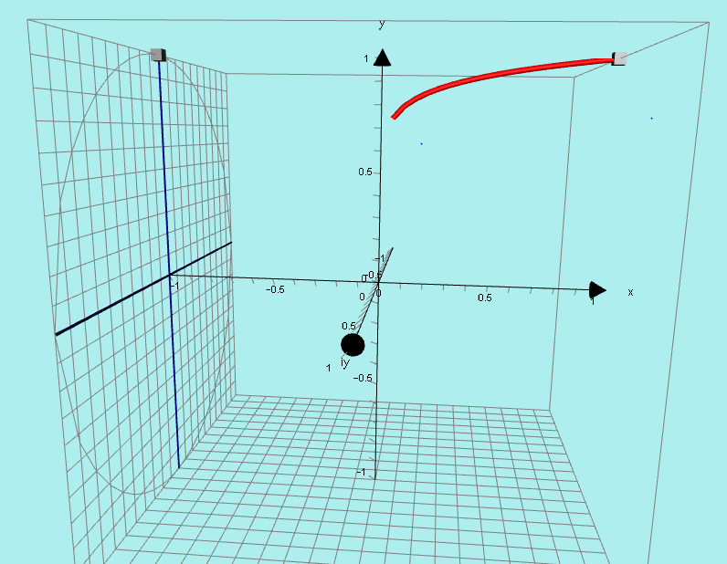
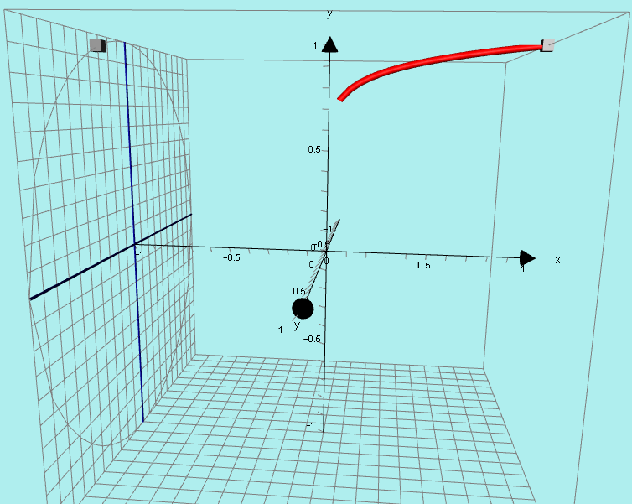
y = x^{0.1}
y = x^{0.1}

Slide 25
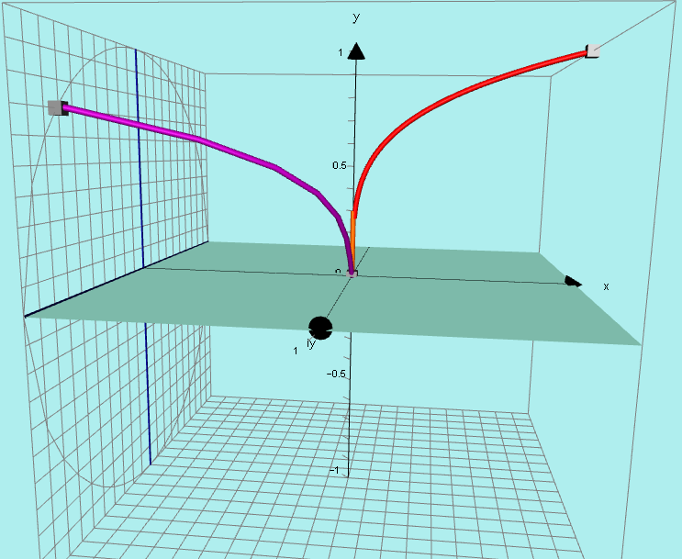
y = x^{0.25}

Slide 26
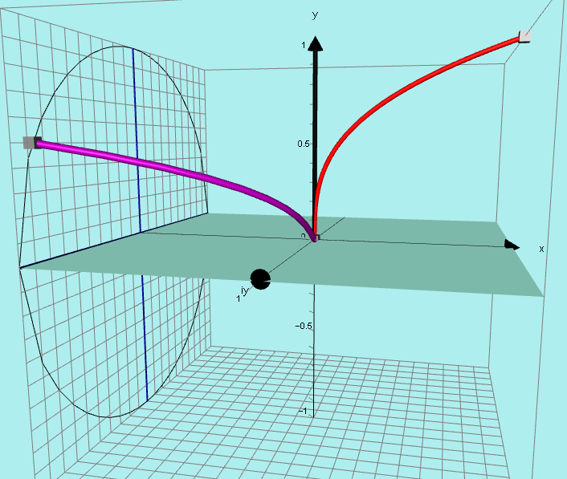
y = x^{0.333}

Slide 27
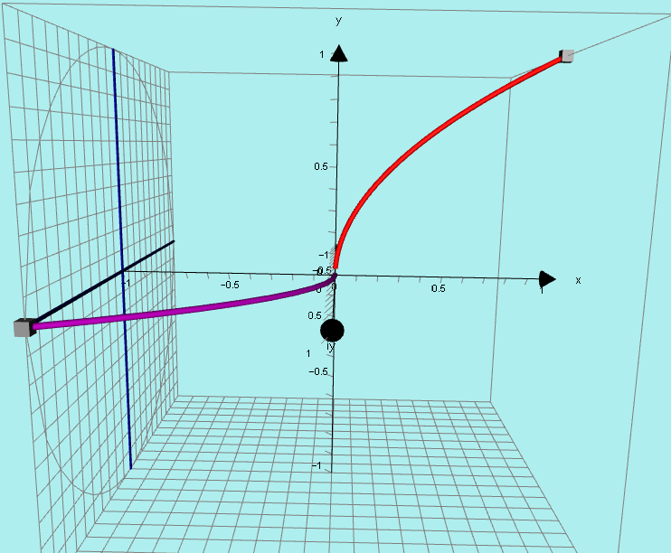
y = x^{0.5}
y = x^{0.5}

Slide 28
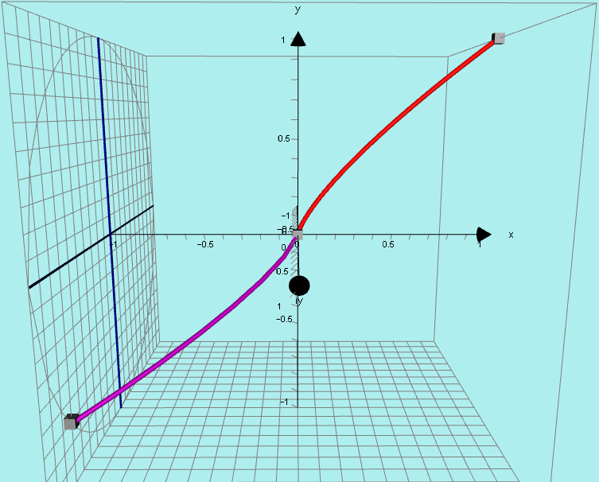
y = x^{0.75}

Slide 29
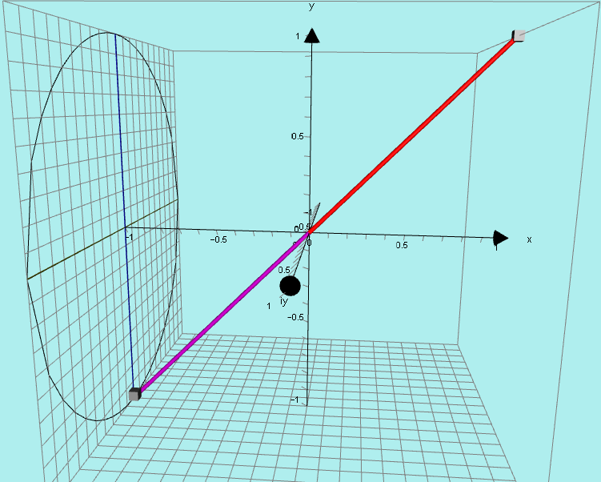
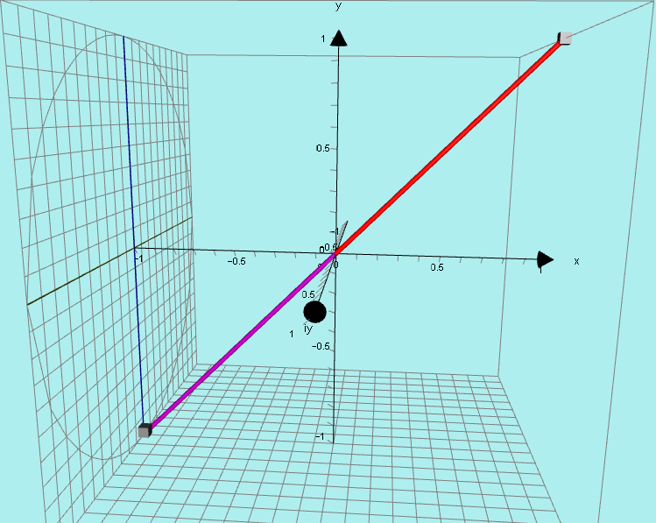
y = x¹
y = x¹

Slide 30
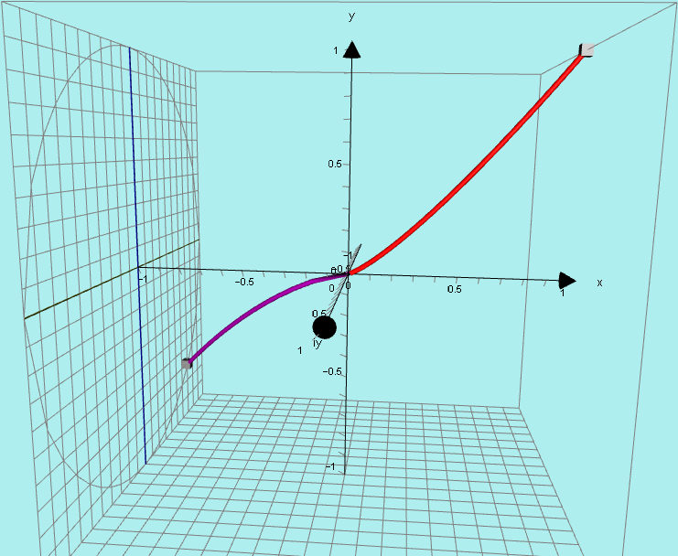
y = x^{1.25}
y = x^{1.25}

Slide 31
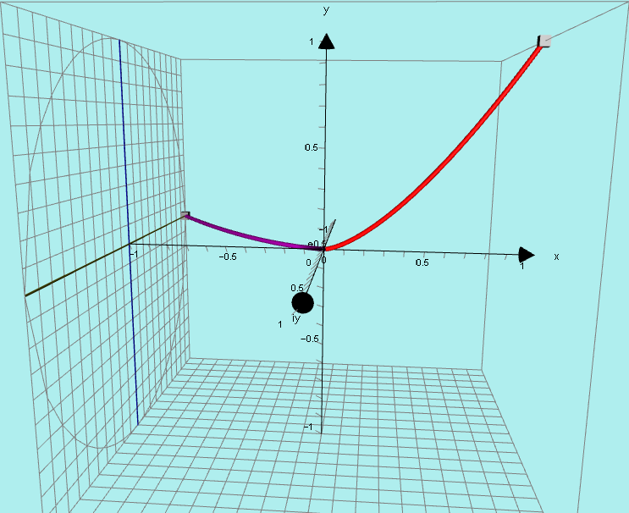
y = x^{1.5}
y = x^{1.5}

Slide 32
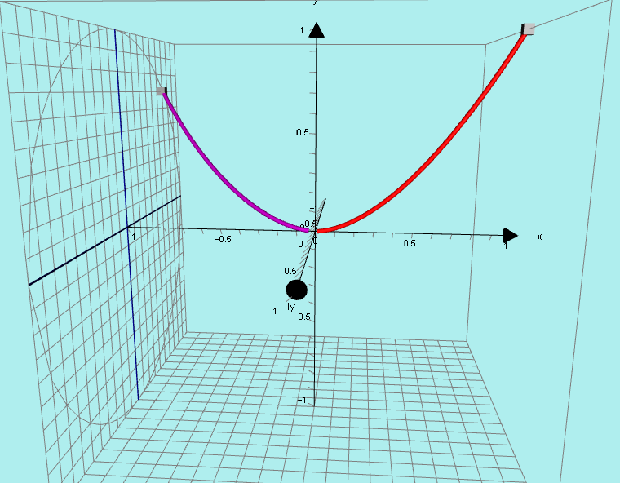
y = x^{1.75}
y = x^{1.75}

Slide 33
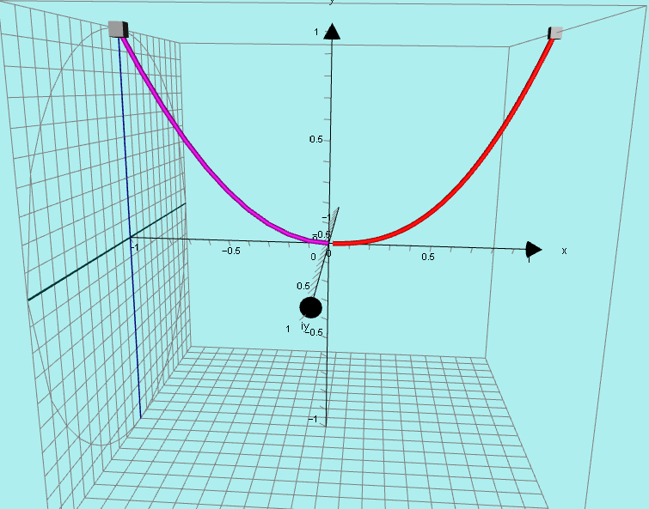
y = x²
y = x²

Slide 34
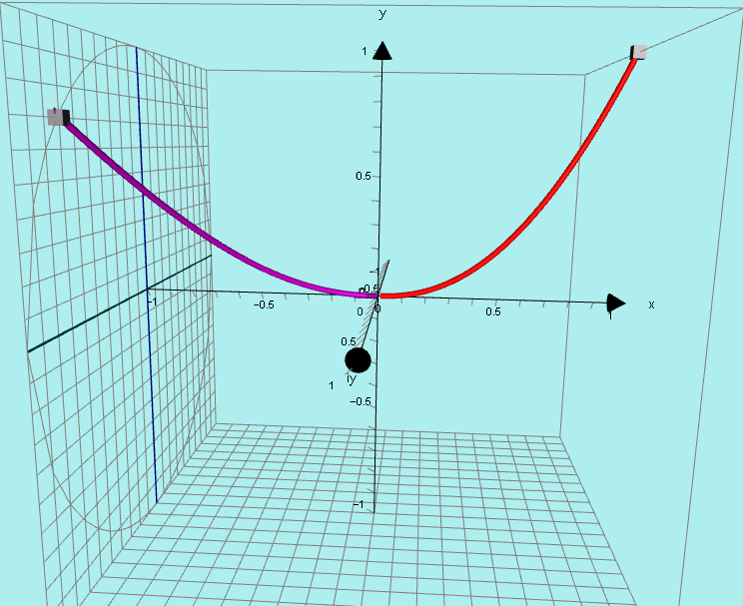
y = x^{2.25}
y = x^{2.25}

Slide 35
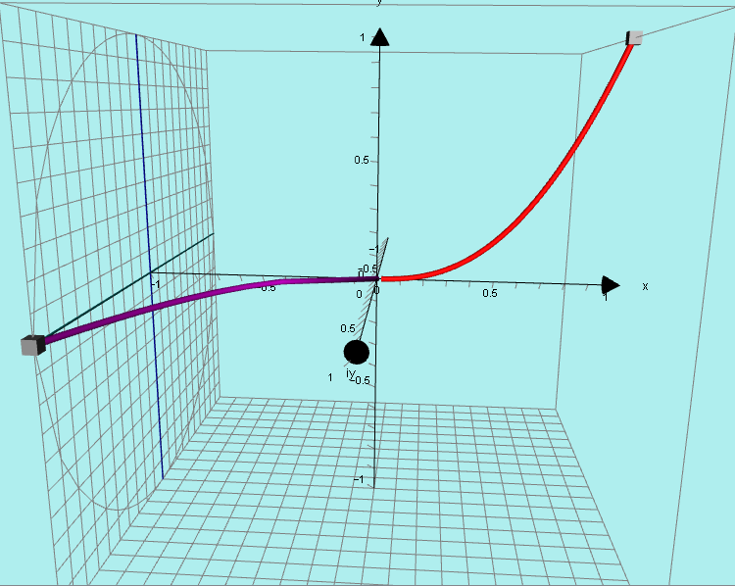
y = x^{2.5}
y = x^{2.5}

Slide 36
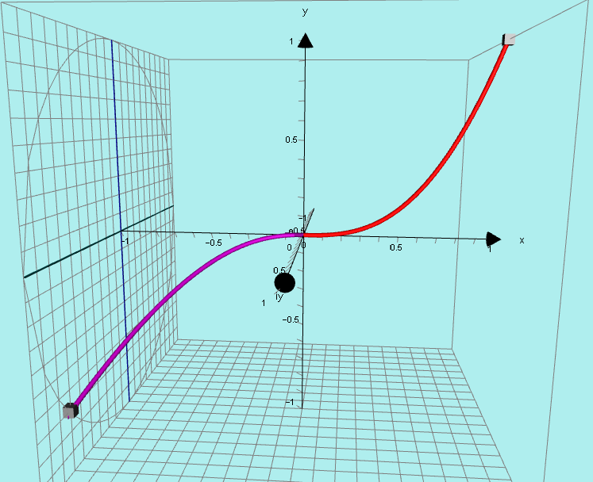
y = x^{2.75}
y = x^{2.75}

Slide 37
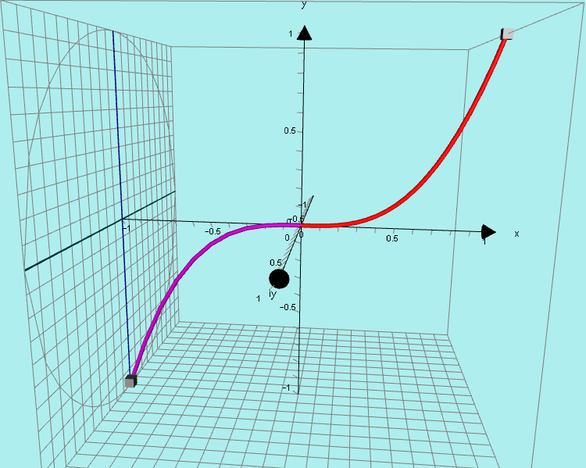
y = x³
y = x³

Slide 38
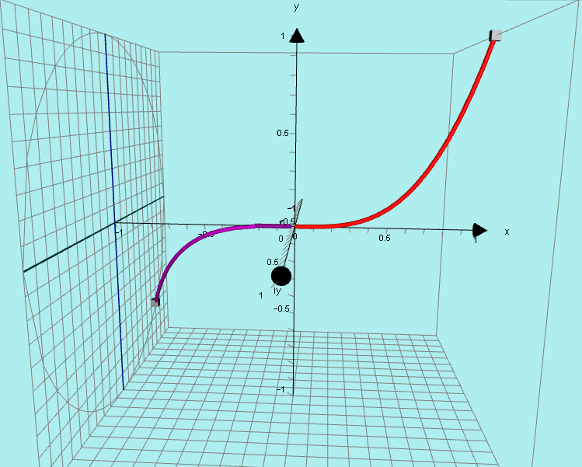
y = x^{3.25}
y = x^{3.25}

Slide 39
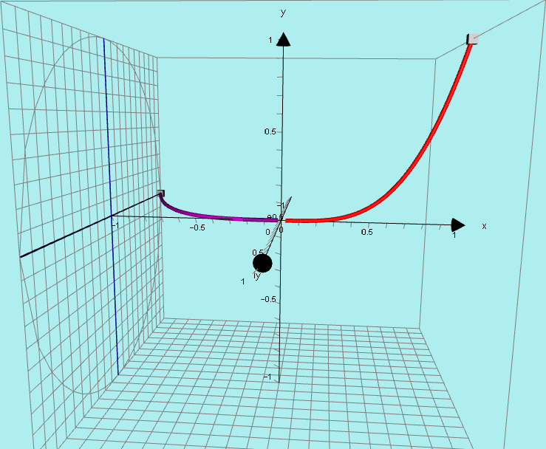
y = x^{3.5}
y = x^{3.5}

Slide 40
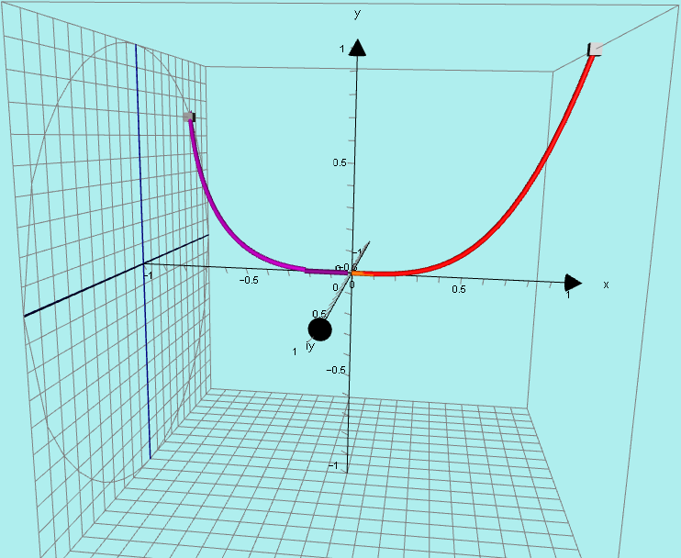
y = x^{3.75}

Slide 41
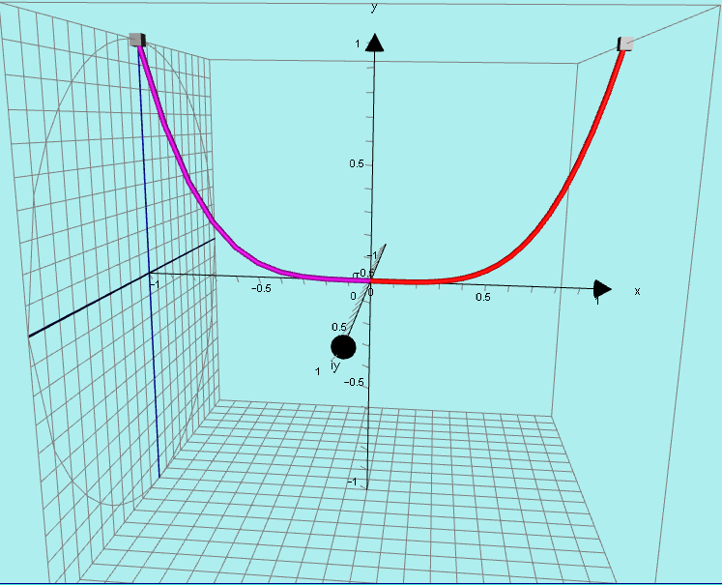
y = x⁴

Slide 42
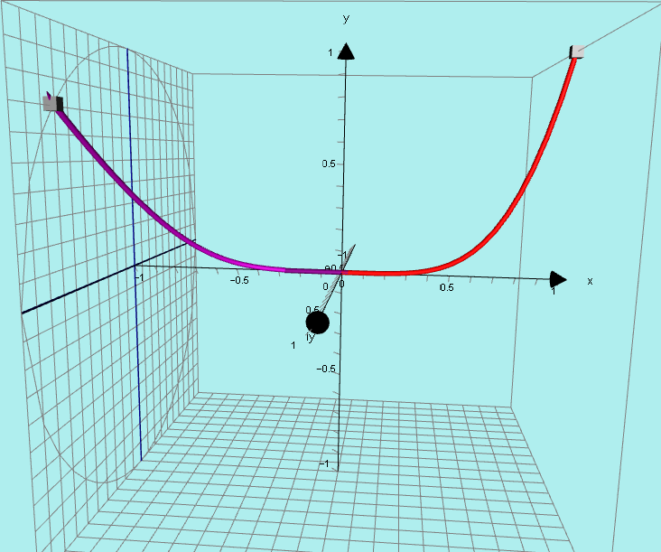
y = x^{4.25}
y = x^{4.25}

Slide 43
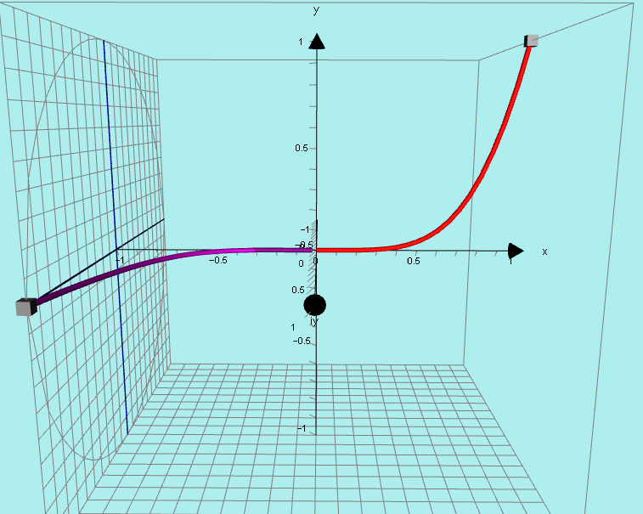
y = x^{4.5}
y = x^{4.5}

Slide 44
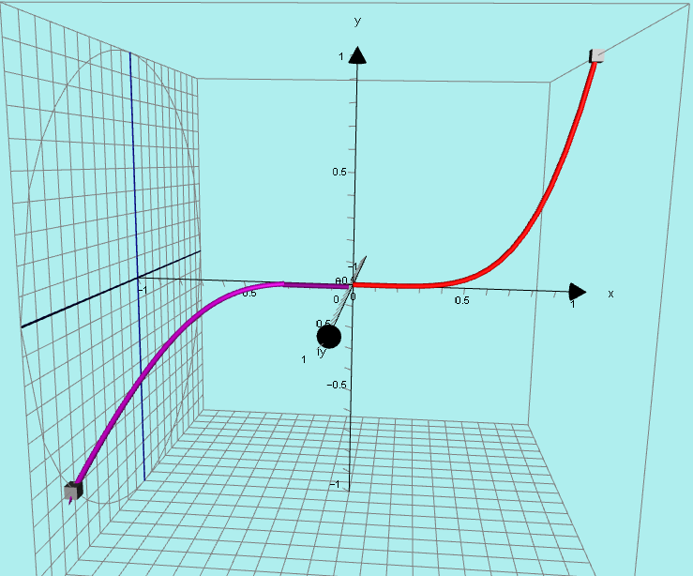
y = x^{4.75}
y = x^{4.75}

Slide 45
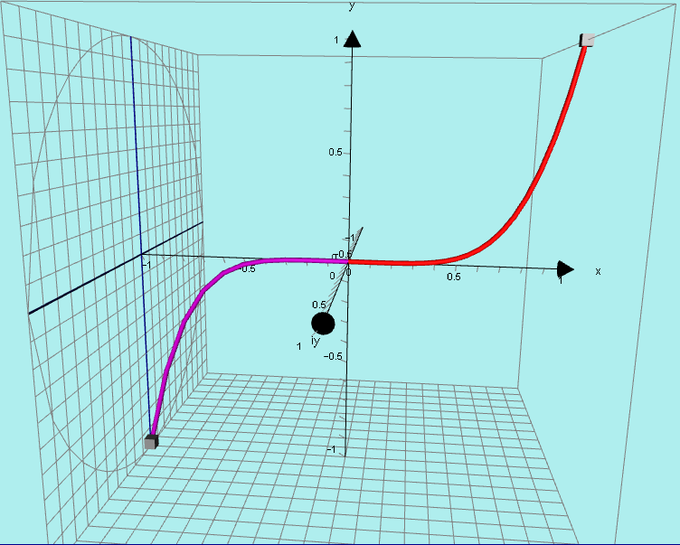
y = x⁵
y = x⁵

Slide 46
I believe this is a totally NEW concept.
I have not met anyone who has ever seen this idea before.

